Slide 1

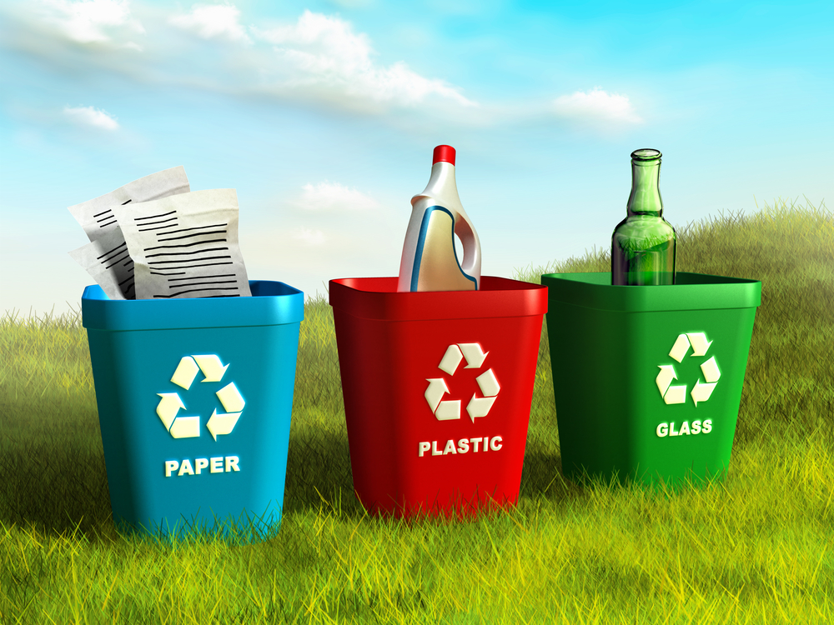

SANGAMESHWAR COLLEGE, SOLAPUR
(AUTONOMOUS)
Solid Waste Management
Presented by :
Mohammad Ayyan Shaikh
2342022
BCA-II

Slide 2

Table of Content
Introduction
What Is Solid Waste Management?
Functional Elements of the Waste Management System
Sources of Solid Waste
Effects of Solid Waste
Advantages
Conclusion

Slide 3
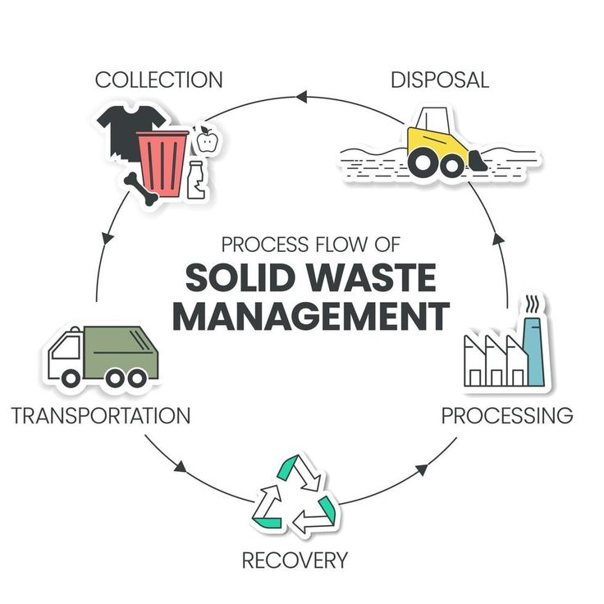
Introduction
Solid waste refers to the range of garbage materials—arising from animal and human activities—that are discarded as unwanted and useless.
A true technological and systematic approach to solid waste management in the US was developed at the end of the 19th century.
In 320 BC, the city of Athens created the first known law that prohibits such careless disposal.

Slide 4
What Is Solid Waste Management?
Solid waste management is defined as the discipline associated with control of generation, storage, collection, transport or transfer, processing and disposal of solid waste materials in a way that best addresses the range of public health, conservation, economic, aesthetic, engineering, and other environmental considerations.

Slide 5
Functional Elements of the Waste Management System
Waste processing and recovery: This refers to the facilities, equipment, and techniques employed to recover reusable or recyclable materials from the waste stream and to improve the effectiveness of other functional elements of waste management.
Onsite handling, storage, and processing: This relates to activities at the point of waste generation, which facilitate easier collection.
Waste collection: A crucial phase of waste management, this includes activities such as placing waste collection bins, collecting waste from those bins, and accumulating trash in the location where the collection vehicles are emptied.

Slide 6
Types of Waste
Municipal Solid Wastes: The general sources of municipal solid wastes are residential complexes commercial and open areas like markets etc.
Industrial Wastes: Originate from various kinds of industries and their varied processes. It includes rubbish, construction and demolition materials etc.
Hazardous Wastes: The sources include industries, nuclear power plants, laboratories and research institutes.
E-WASTE: This includes Large and small household appliances,IT equipment,Consumer electronics, such as smartphones, televisions, and computers,Light fixtures,Toys,Tools,Medical devices,Batteries,Stereo

Slide 7
ADVANTAGES
Keeps the environment clean and fresh.
Saves the Earth and conserves energy.
Reduces environmental pollution.
Waste management will help you earn money.

Slide 8
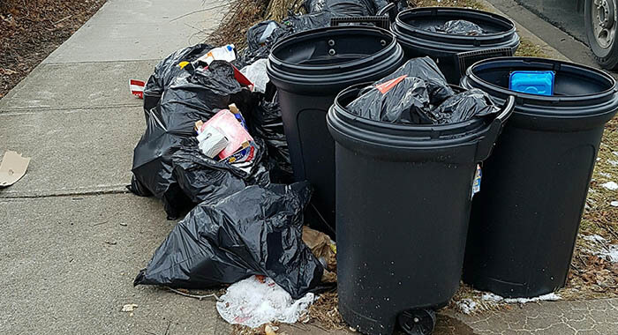
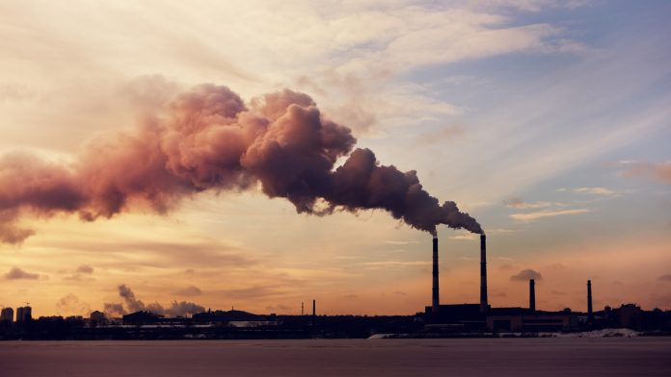
Various Sources of Solid Waste
1. Residential
Residences and homes where people live are some of the major sources of solid waste. The garbage from these places includes food wastes, plastics, paper, glass, leather, cardboard, metals, yard wastes, ashes and special wastes like bulky household items such as electronics, tires, batteries, old mattresses and used oil.
2. Industrial
Industries are known to be one of the biggest contributors to solid waste. They include light and heavy manufacturing industries, construction sites, fabrication plants, canning plants, power and chemical plants.

Slide 9
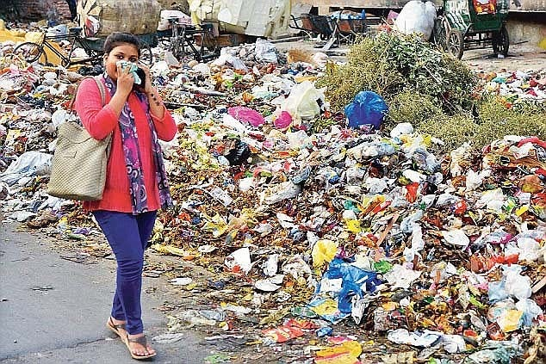
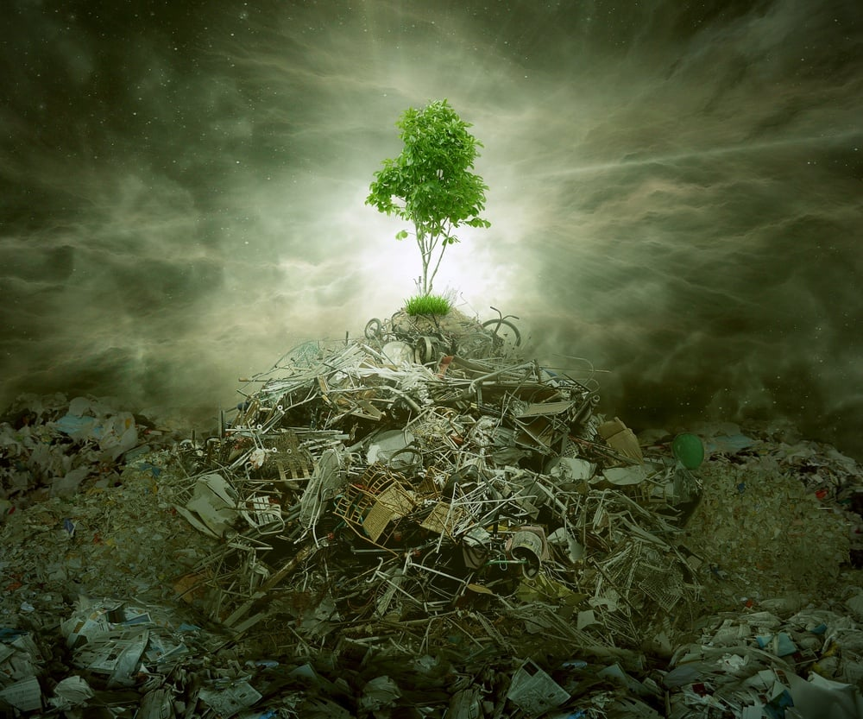
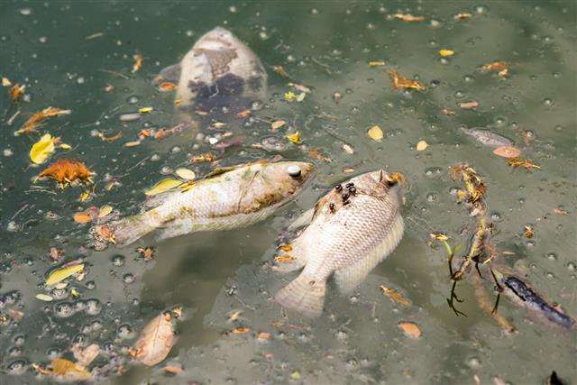
Effects of Poor Solid Waste Management
Impact on Human Health
By burning the paper and other scraps along with the hazardous wastes,dioxins and poisonous gasses are produced and released into the air which result in causing various disease including chronic disease,skin infections,cancer etch.
Environmental Problems
Accumulation of these wastes can cause land pollution,degradation of landscape,soil contamination,air pollution,water pollution health issues,and even the extinction of terrestrial and aquatic species.
Impact on Aquatic Animals
Due to the dumping of waste containing toxic chemicals,water bodies,aquatic life,and marine life get severely affected.impact of wastes on aquatic life is reduction in the growth of fish,diminished survival ability,as well as species extinction.

Slide 10
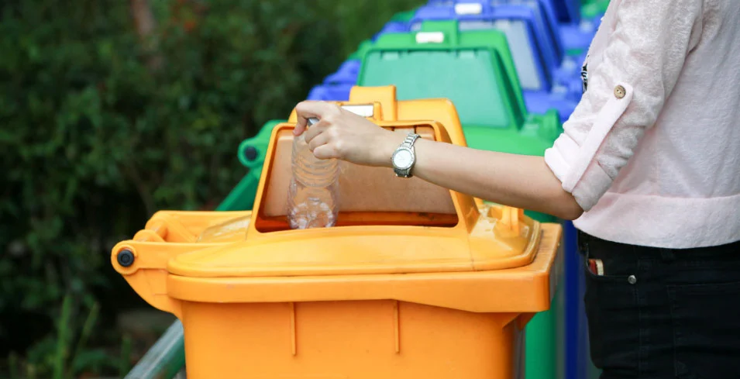
Why Should We Recycle?
• Reduces reliance on landfills and incinerators. • Recycling protects our health and environment when harmful substances are removed from the waste stream. • Recycling conserves our natural resources because it reduces the need for raw materials.

Slide 11
Conclusion
As long as there is human activity, solid waste will be a part of us. But the good thing is that by exercising a sense of responsibility and following sensible regulations, we can definitely live a better and cleaner life even with solid waste around.

Slide 12
Thank You
For Your Time & Attention

